Slide 1
Final Design Presentation
– ELEC 3040-001

Slide 2
Desired Functionality of the Design
Decode and display pressed key value
Produce 10 PWM duty cycles at 10kHz
Duty cycle of PWM determined by key value
A motor with 10 speeds driven by PWM
A decade counter with 10 second steps
A key to start and stop the counter
A key to change direction of the counter

Slide 3
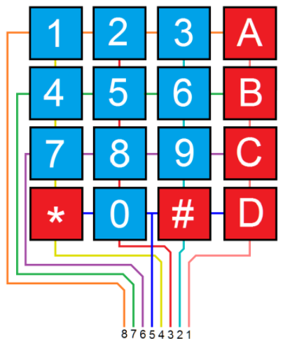
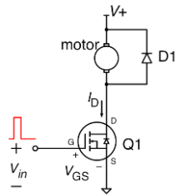
How Will We Accomplish This?
What we learned
Lab 1: Project Creation
Lab 2: Decade Counter
Lab 3: Interrupt Design
Lab 4: Keypad Control
Lab 5: Programable Timers
Lab 6: PWM Generator
Lab 7: Motor Drive

Slide 4
Program Flowchart
Setup
Pins
If Key
0-A
Update
PWM
Output Key Value
Delay
Count
If Key
* Or #
Update
Up/Run
Clear
Variables
Read
Keys
If Key
B, C, or D
No Change
Delay
3 Times

Slide 5
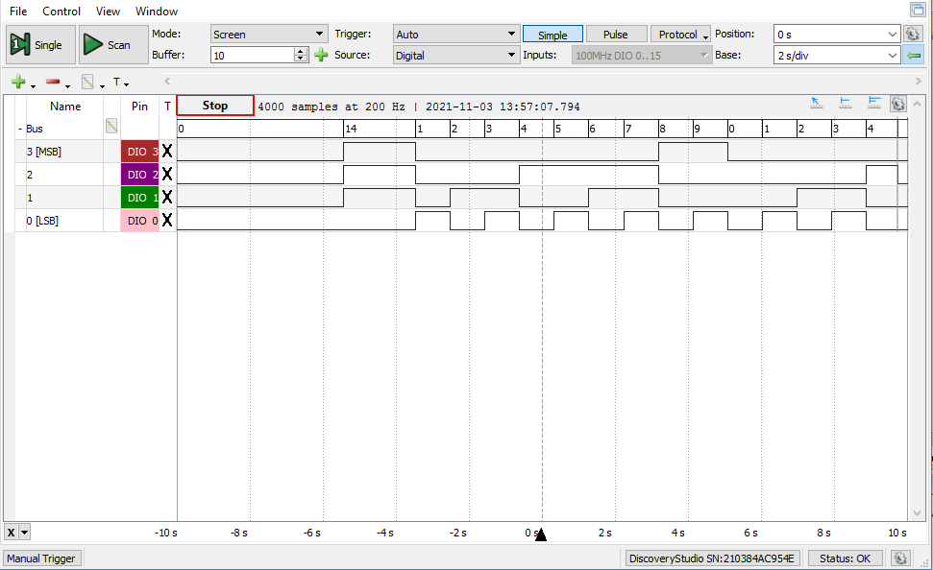
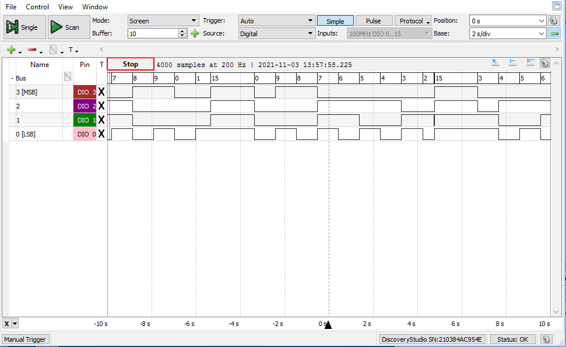
Testing The Counter
Counter loops from 9 down to 0
Counter does not start until * pressed
Counter changes direction when # pressed

Slide 6
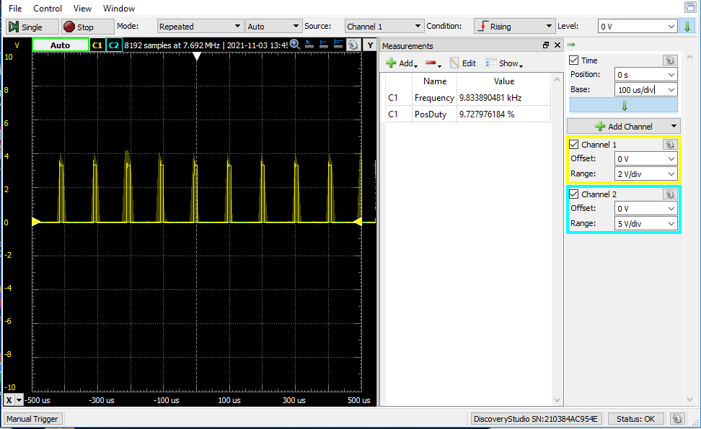
Testing at 10% Duty Cycle

Slide 7
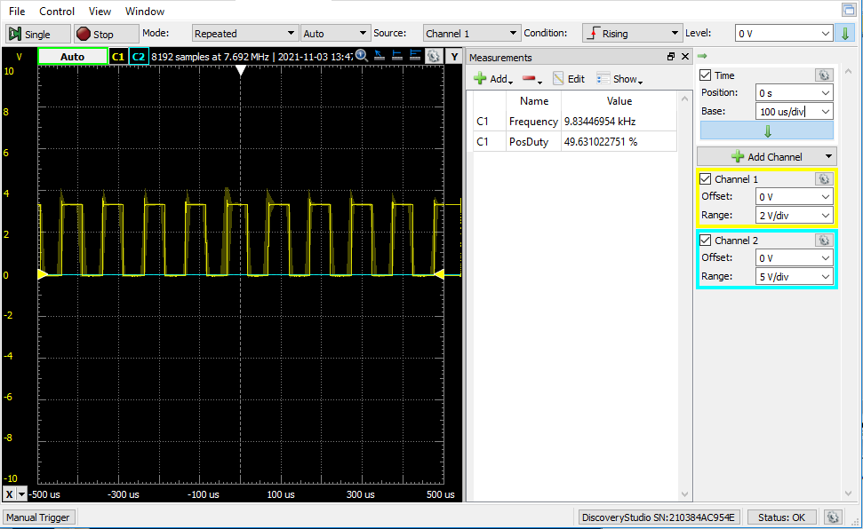
Testing at 50% Duty Cycle

Slide 8
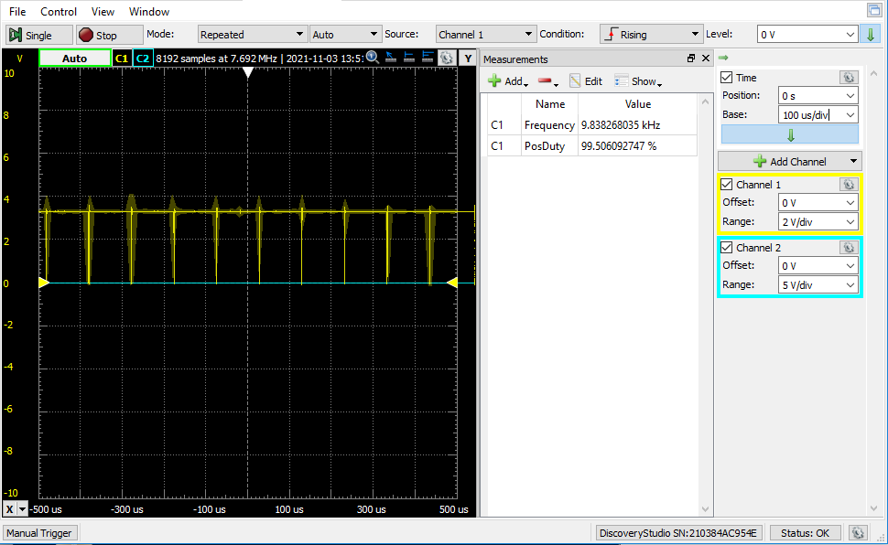
Testing at 100% Duty Cycle

Slide 9
Frequency vs Duty Cycle

Slide 10
Voltage vs Duty Cycle

Slide 11
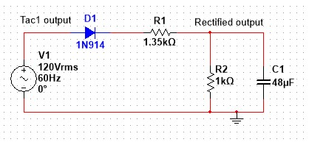
Extra Credit: ADC
Did NOT finish the extra credit
ADC works but never implemented in code
Used Half-wave rectifier circuit
***Note: Circuit should work as long as R2 is roughly 70% of R1

Slide 12
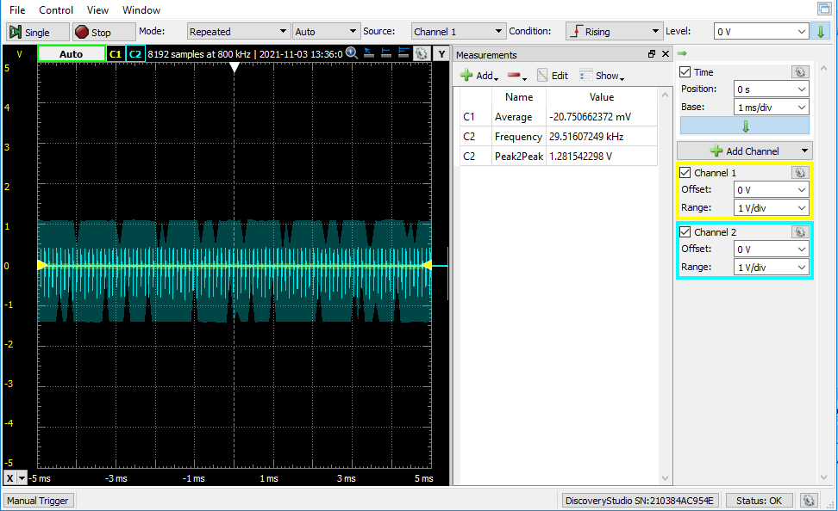
ADC at 10% Motor Speed

Slide 13
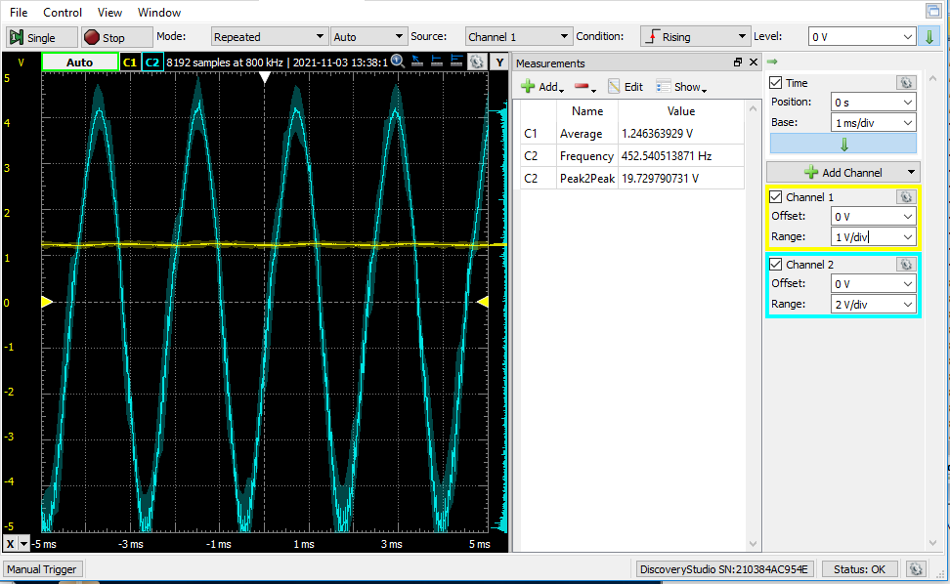
ADC at 50% Motor Speed

Slide 14
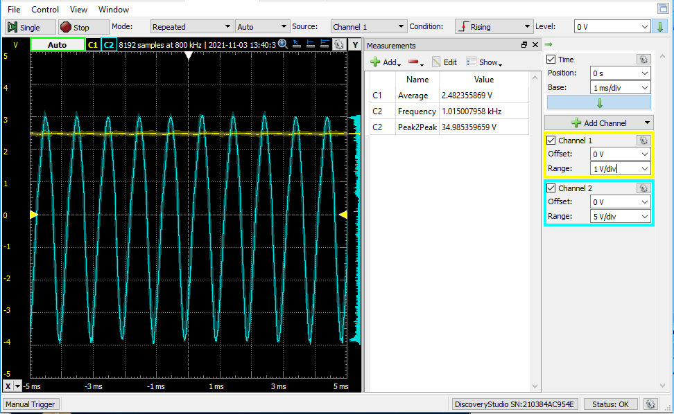
ADC at 100% Motor Speed

Slide 15
Conclusions
Problems Faced
What I Learned
General Coding Syntax
Keypad reading Algorithm
Debouncing Timing
Developing Test Procedure
Proper Communication
Getting ADC to work
Effective use of If, While, and Delay
Switching pins fixed scanning issue
Proper timing to preserve key value
Using Logic Analyzer and Oscilloscope
Speak and write more professionally

